Slide 1
Integrating Non-Volatile Memory into Database Systems
Haoyu Gong

Slide 2
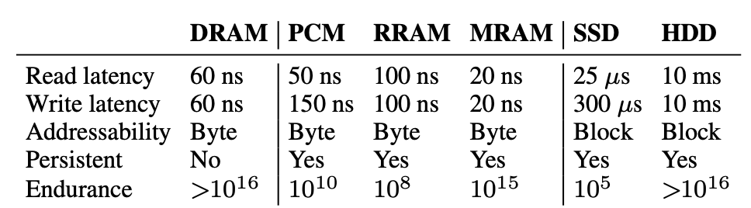
New Non-Volatile Memory
DRAM-like Performance
Byte-addressable
Persistent Writes
Large storage Capacity

Slide 3
Motivation
Two Types of DBMS
  Disk-oriented systems
  Memory-oriented systems
Key Assumption
  The difference in the performance characteristics of volatile (DRAM) and non-volatile storage devices (HDD/SSDs) influences the design of database management systems (DBMSs).
  The latter is much slower than the former.
Characteristics of NVM
  Byte-Addressability
  High Write Throughput
  Persistent Writes
  Read-Write Asymmetry

Slide 4
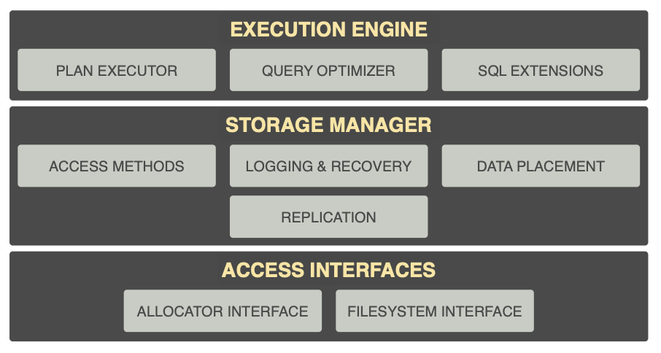
NVM-Aware Components
The main components of a DBMS that are affected by NVM

Slide 5
Access Interfaces
  Allocator Interface
  Filesystem Interface
Storage Manager
  Access Methods
  Logging & Recovery
  Data Placement
  Replication
Execution Engine
  Plan Executor
  Query Optimizer
  SQL extensions

Slide 6
Access Interfaces
Two Access Interfaces
  Allocator Interface
  Filesystem Interface
Pros & Cons
  Filesystem interface supports a naming mechanism
  Allocator interface does not automatically provide a naming mechanism
  Filesystem interface requires the application’s writes to go through the kernel’s virtual filesystem (VFS) layer
  Allocator interface can write to and read from NVM directly within user space

Slide 7
Access Interfaces
Design NVM-aware Memory Allocator Allocator Interface
  Durability mechanism
  Naming mechanism
  Atomicity mechanism
Programming Challenges with NVM
  Data consistency
  Data recovery
  Persistent memory leaks
  Partial writes
  Persistent memory fragmentation
  Address space fragmentation

Slide 8
Access Interfaces
  Allocator Interface
  Filesystem Interface
Storage Manager
  Access Methods
  Logging & Recovery
  Data Placement
  Replication
Execution Engine
  Plan Executor
  Query Optimizer
  SQL extensions

Slide 9
Storage Manager
Access Methods
  NVM-Aware B+tree index
    High overhead for consistency guarantee
    Slow data recovery after system restart
  Related Work
    NV-tree
    wB+tree
    FPtree
  Hash Index
    High overhead for consistency guarantee
    Performance Degradation for Reducing Writes
    Cost Inefficiency for Resizing Hash Table

Slide 10
Storage Manager
Logging & Recovery
  WAL(Write Ahead Log)
    Unnecessary data duplication
  NVM enables a better logging protocol than WAL
    Higher write throughput
    Smaller gap between sequential writes and random writes
    Byte-addressability
  Related Work
    WBL(Write Behind Log): records the tuple’s contents in the database even before it writes any associated meta-data in the log.

Slide 11
Storage Manager
Data Placement
  The impact of dynamic data placement on a multi-tier storage hierarchy containing NVM must be explored in future work.

Slide 12
Storage Manager
Replication
  Types of Failure
    Transaction Failure
    System Failure
    Media Failure
  These failures are instead overcome through replication
  Expect logging scheme designed for NVM in this replicated environment.

Slide 13
Access Interfaces
  Allocator Interface
  Filesystem Interface
Storage Manager
  Access Methods
  Logging & Recovery
  Data Placement
  Replication
Execution Engine
  Plan Executor
  Query Optimizer
  SQL extensions

Slide 14
Execution Engine
Plan Executor
  Need to redesign the algorithms backing the relational operators to reduce the number of writes to durable storage, given the read-write asymmetry and limited write-endurance of NVM. (sort, join)
Query Optimizer
  Differentiate between reads and writes, and take into consideration the convergence of sequential and random accesses in NVM.
  Adapted cost functions should account for the byte-addressability of NVM.
SQL Extensions
  The DBMS contains certain SQL extensions to allow the user to control data placement on NVM.

Slide 15
Conclusion
The advent of NVM invalidates the long-held assumption that durable storage is several orders of magnitude slower relative to the DRAM.
It is important to reexamine the design choices made in different components of the DBMS to leverage the raw device performance differential.

Slide 16
Thank you!
Haoyu Gong

